Slide 1
I am functional and oO can Too!
Will Pleasant-Ryan

Slide 2
Functional Programming is great
Functions!
first-class citizens
closures
partial application / currying
Composition
Immutability!
No side effects
Deep Equality
reduce surprises / hidden complexity
easier to analyze & test
Notes:
Specific example where immutability would have helped an AO project

Slide 3
Functional Programming is great
But Wait there’s more!
Algebraic data types – expressively constrain valid states
Monads – control data flow
Homoiconicity – code-as-data, METAPROGRAMMING

Slide 4
But sometimes Functional programming isn’t the right choice
Explicit customer requirement
Customer ecosystem
Eventual maintainers
Existing libraries / ecosystem in problem domain

Slide 5
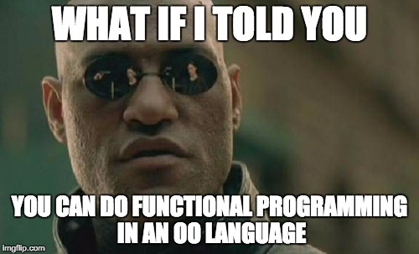

Slide 6
Functional OO
We’ll Examine techniques for writing more functional code in:
Ruby
C#
Javascript

Slide 7
Functions As First-Class Citizens
Ruby
Uses Methods / SIGNALS, Not Functions
A Proc is about the closest Ruby has to a function
You might have seen arr.map(&:object_method), but you can use it on static methods
Notes:
A Proc is the closest thing ruby has to a function
You might know about &:mul2, you can apply to_proc to a method object

Slide 8
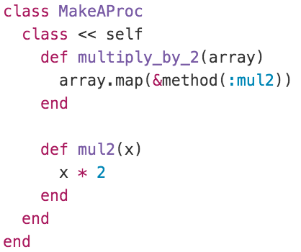
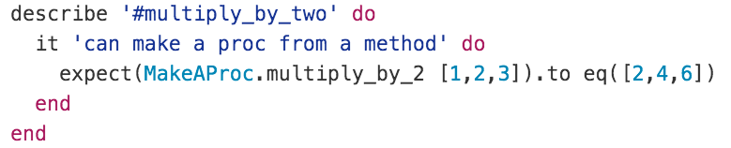
Functions As First-Class Citizens

Slide 9
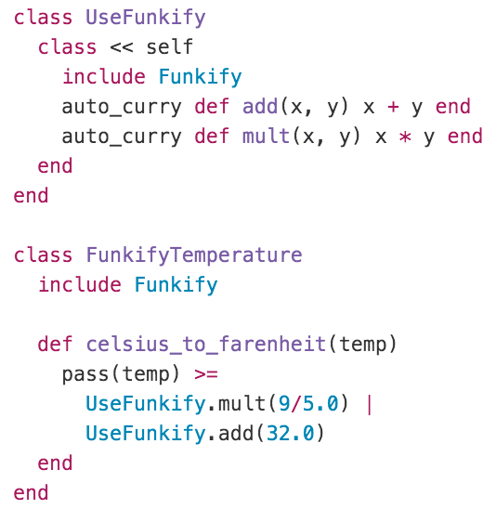
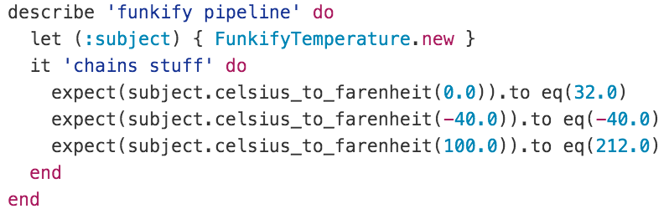
Partial Application / CURRYING / Function Composition
Notes:
Illegible to call func(func(func(x))), ugly to assign each step
Backward composition is more legible

Slide 10
Functions As First-Class Citizens
C#
Static *MOSTLY* IMPLIES PURE
Use delegates
or Func<X,Y,Z> (which is a delegate)

Slide 11
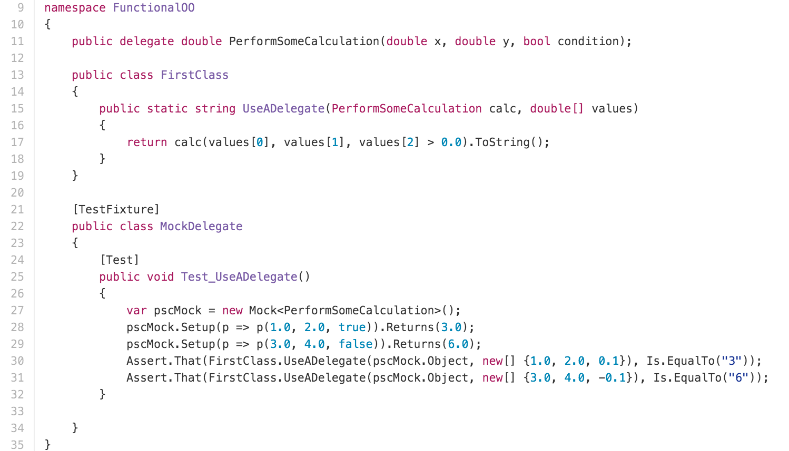
Functions As First-Class Citizens

Slide 12
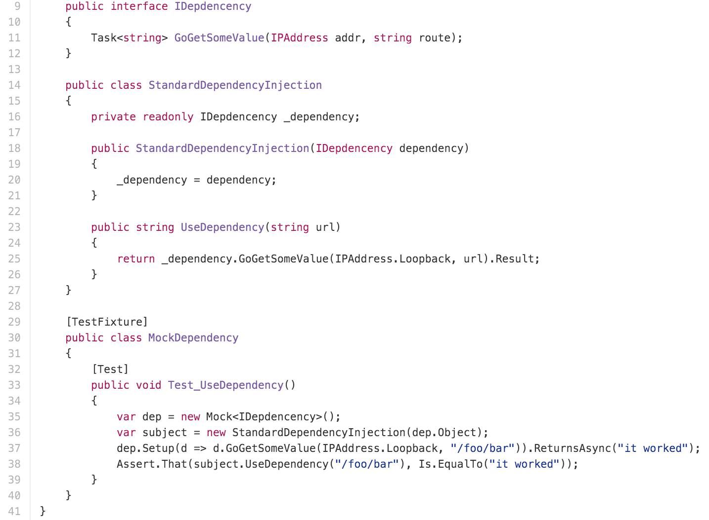
Partial Application / CURRYING
Notes:
You could use this structure to build up an implementation of Pythag that has Add, Mult, Sqrt, etc., but that is a TON of boilerplate when you just want a few functions. Let’s try it with delegates:

Slide 13
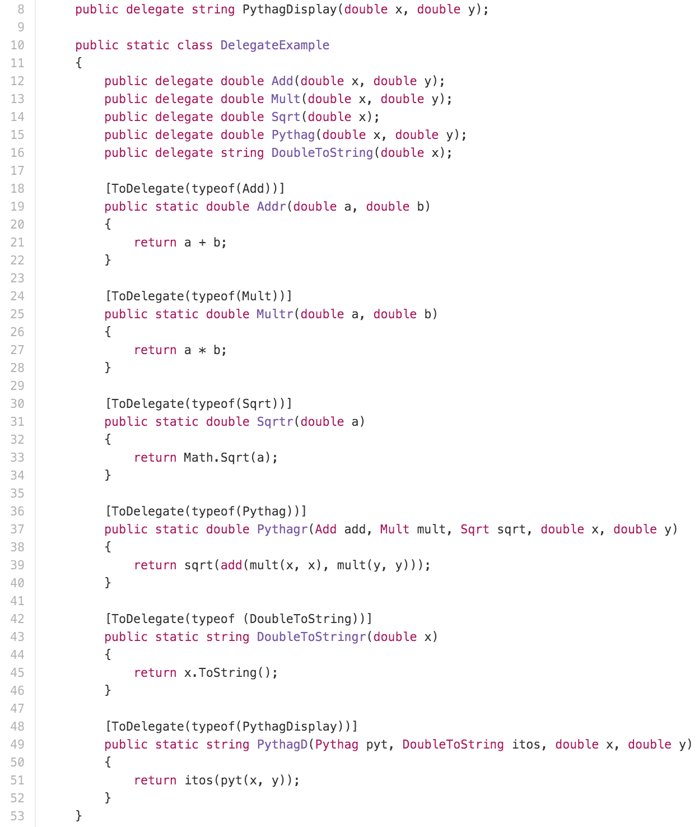
Partial Application / CURRYING
MethodToDelegate
Partial Application

Slide 14
Partial Application / CURRYING
MethodToDelegate – ReturnDelegate EXAMPLE

Slide 15
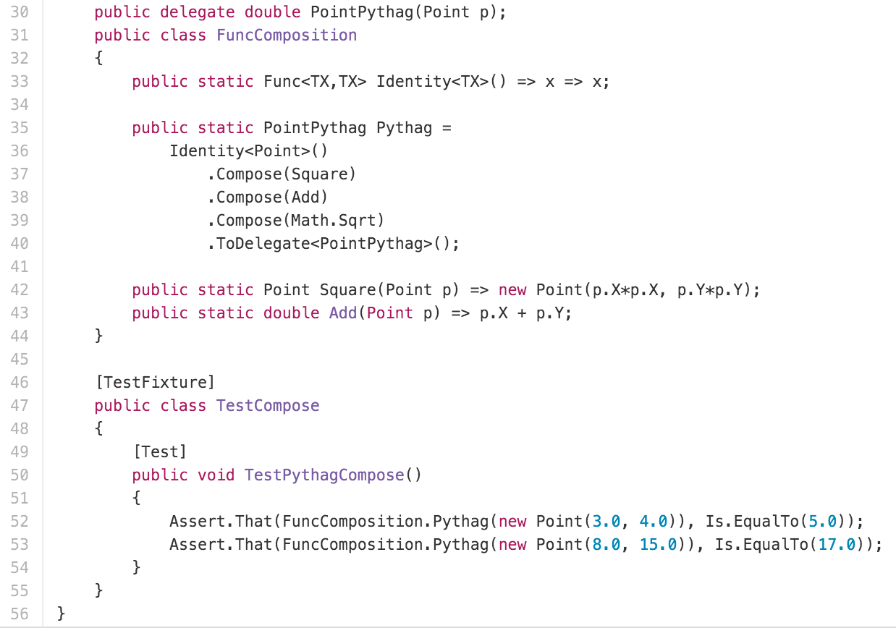
FUNCTION COMPOSITION

Slide 16
Functions As First-Class Citizens
Javascript
Built in

Slide 17
Partial Application / CURRYING / Function Composition
Use bind()
Compose is (mostly) straightforward
Dependency injection systems (e.g. Ember service registry)

Slide 18
Questions?

Slide 19
IMMUTABILITY IN RUBY
Hamsterdam GEM
Works like Ruby’s Struct
Built on Hamster library or Clojure’s IMMUtable structures

Slide 20
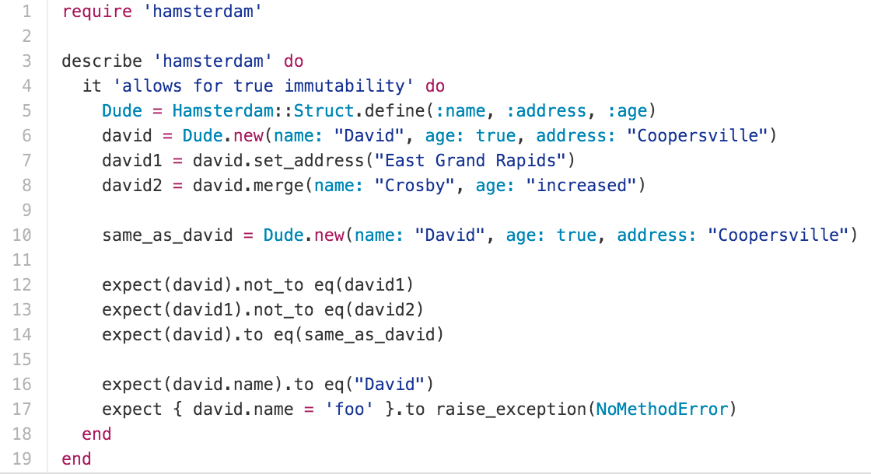
IMMUTABILITY IN RUBY

Slide 21
IMMUTABILITY IN C#
C# is statically typed and so a library can’t really introduce usable immutability
However you can create immutable structures “LONGHAND”
Adding equality is a real pain

Slide 22
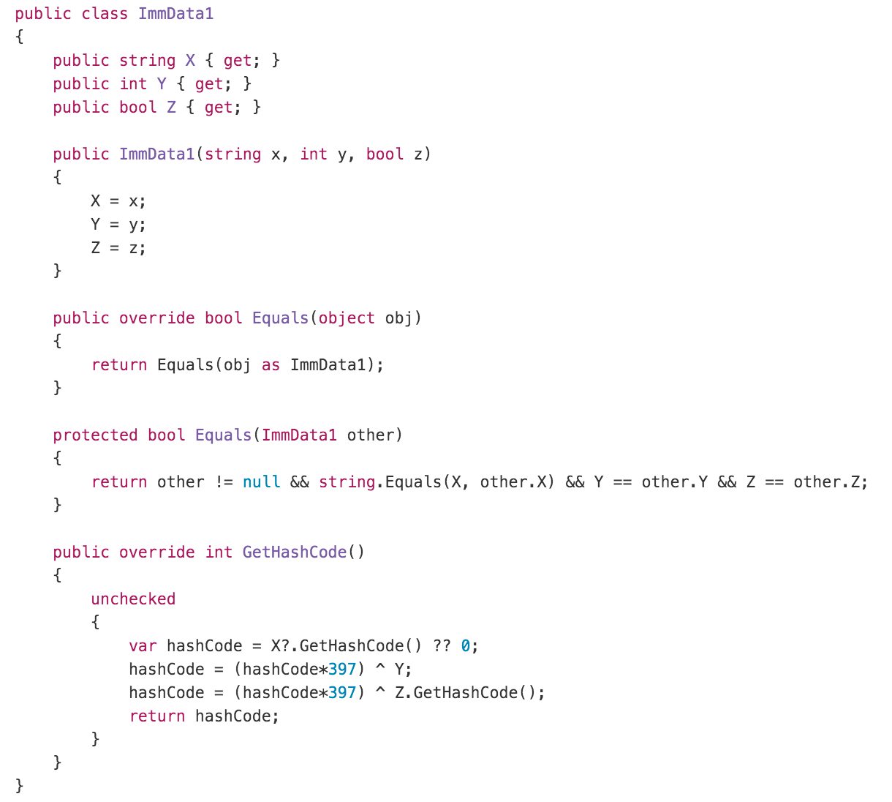
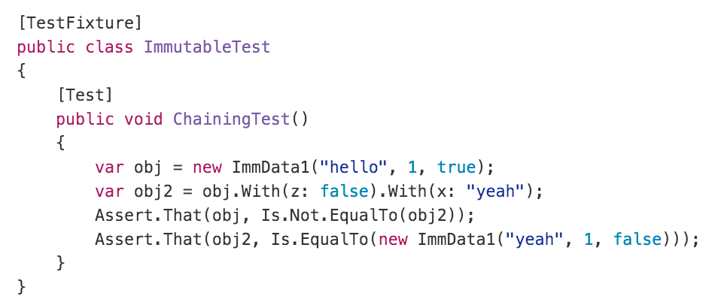
IMMUTABILITY IN C# - LONGHAND

Slide 23
IMMUTABILITY IN C# - t4 Templates

Slide 24
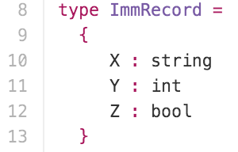
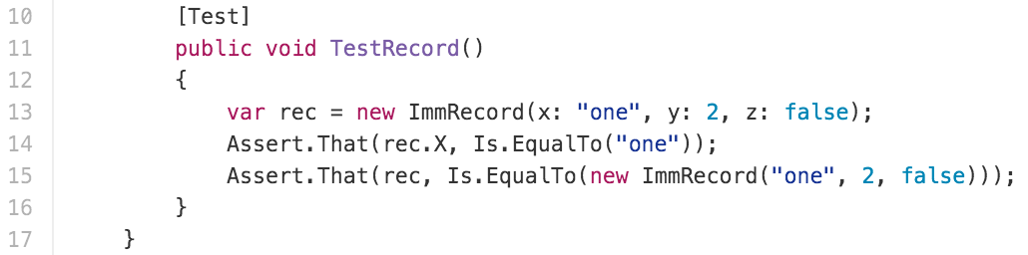
IMMUTABILITY in C# - F# Interop
Notes:
Use same field names

Slide 25
IMMUTABILITY in C# - MOCKING
An interesting technique - Mock as if immutable
Wrap mutable libraries “As if immutable”
Instead of void Func(Foo)
Use Foo Func(Foo) and return the mutated input
Or create a thin wrapper
oWrap<Foo> Func<Foo>(Wrap<Foo> wf) { wf.Foo.Mutate(); return new Wrap(wf.Foo); }
Treated mocked functions as immutable

Slide 26
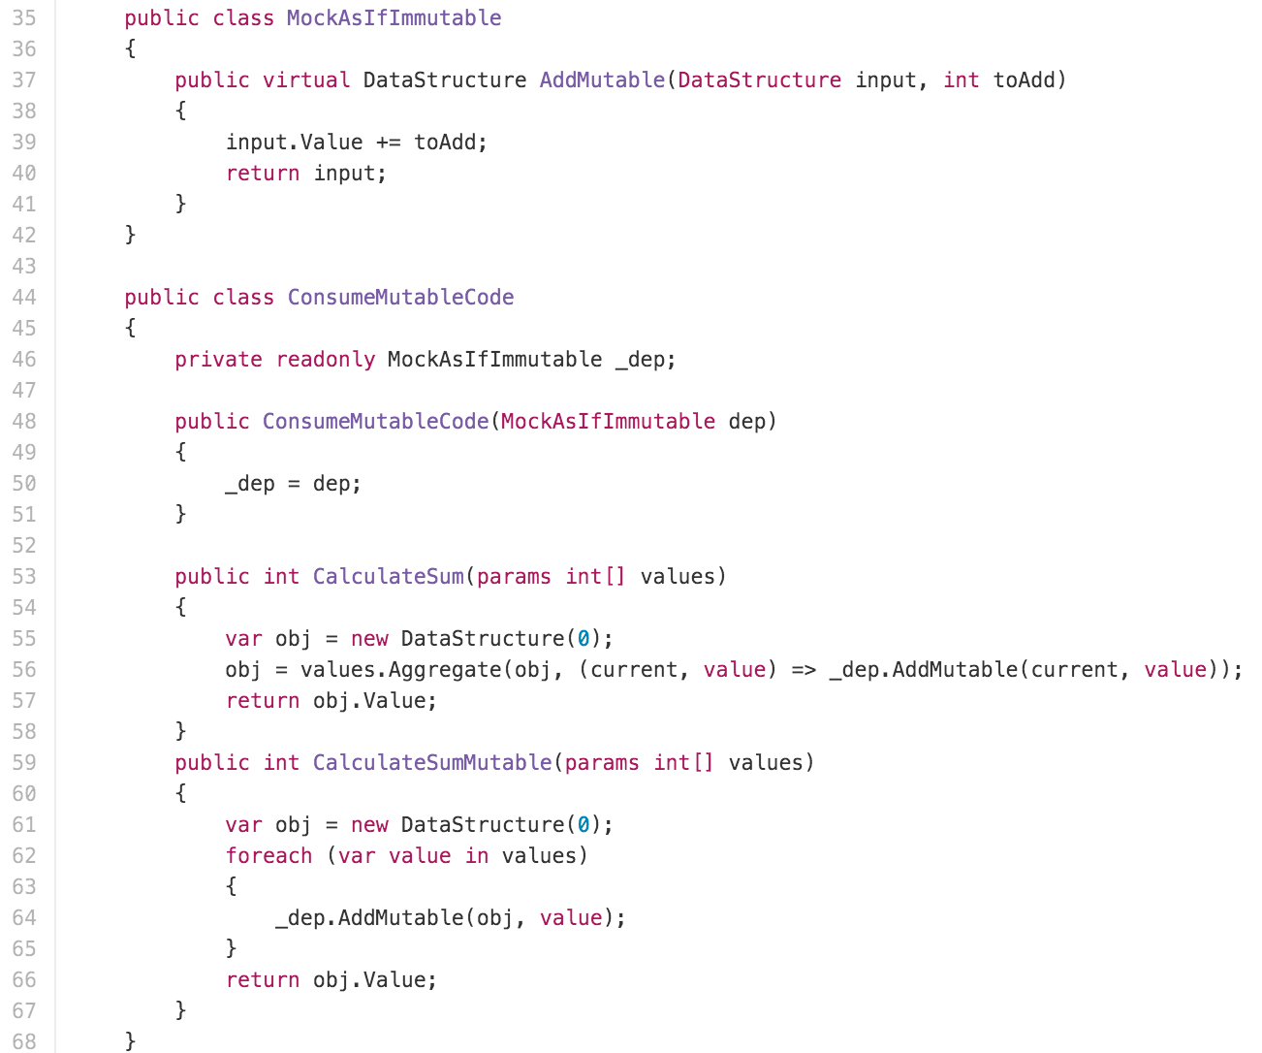
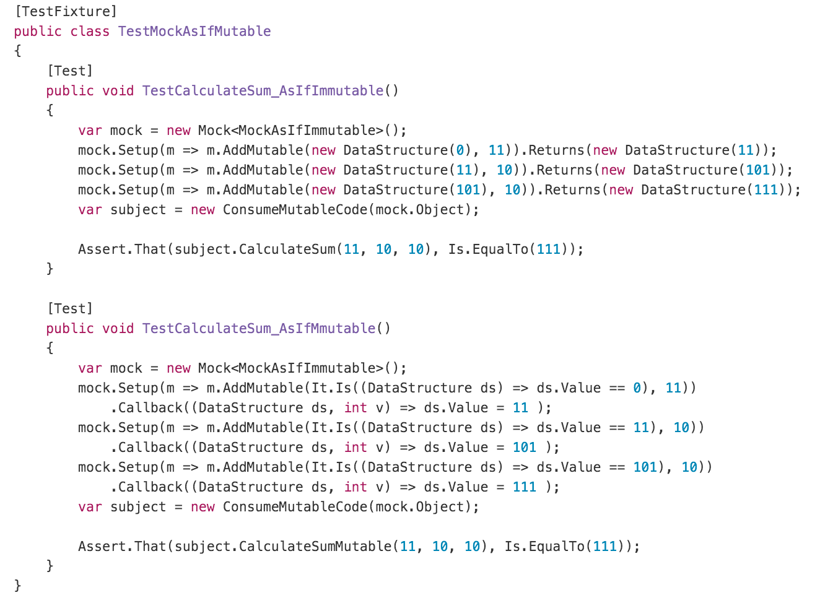
IMMUTABILITY IN C# - MOCKING

Slide 27
IMMUTABILITY in Javascript
Immutable library
Freeze()

Slide 28
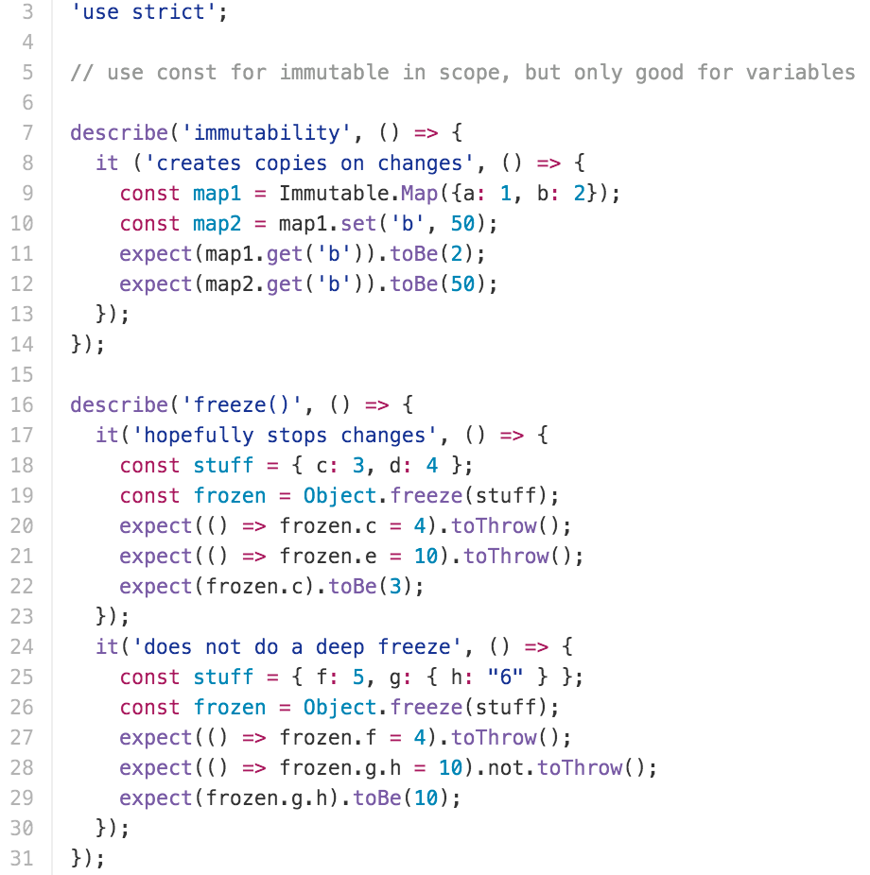
IMMUTABILITY IN JAVASCRIPT

Slide 29
Questions?, Part 2

Slide 30
Functional Programming is great
But Wait there’s more!
Algebraic data types – expressively constrain valid states
Monads – control data flow
Homoiconicity – code-as-data, METAPROGRAMMING

Slide 31
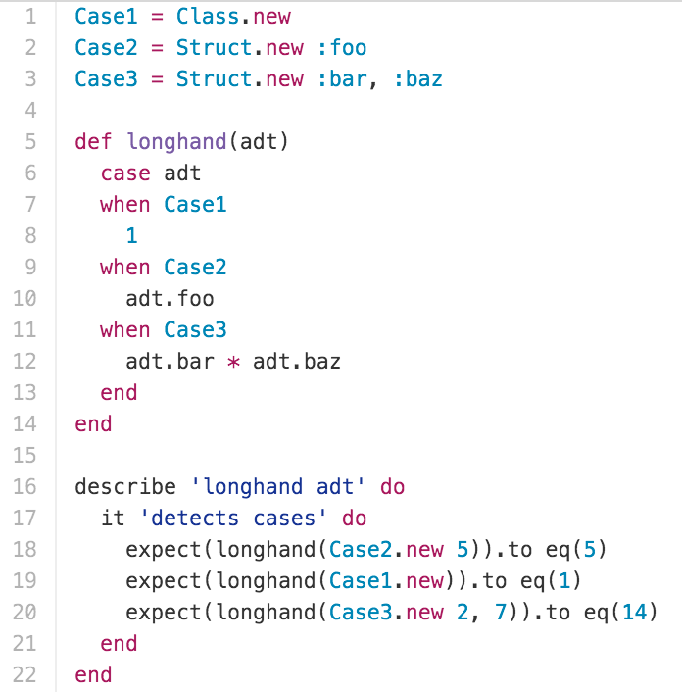
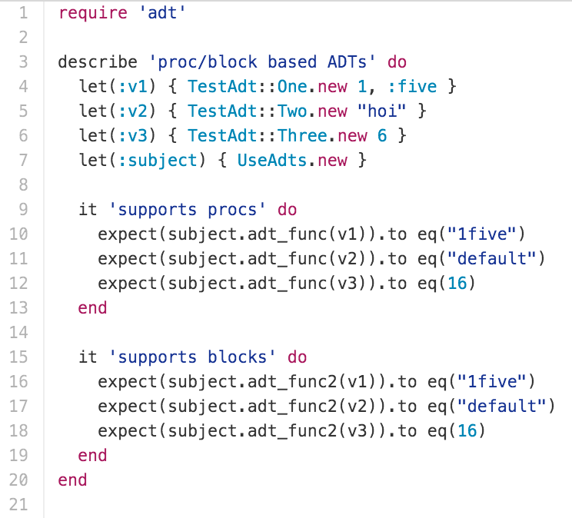
Algebraic Data types IN RUBY

Slide 32
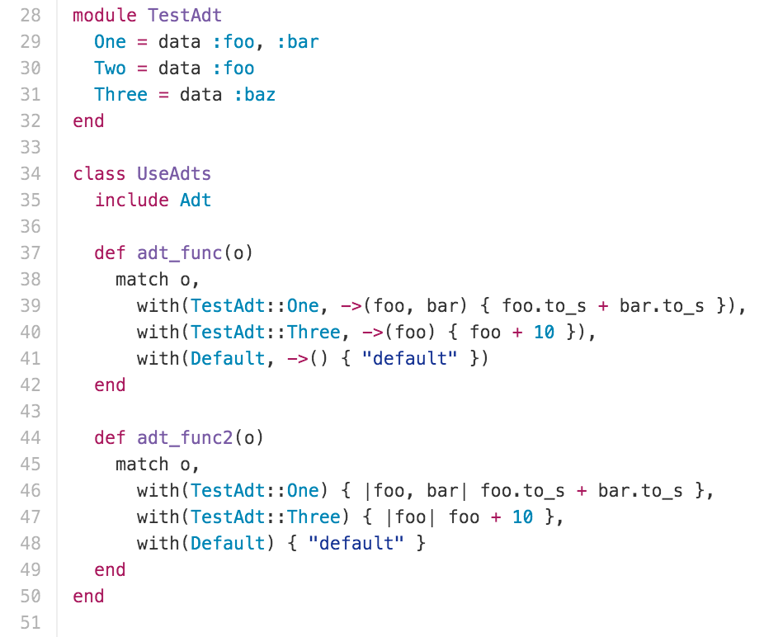
ADTS IN RUBY - MONADT

Slide 33
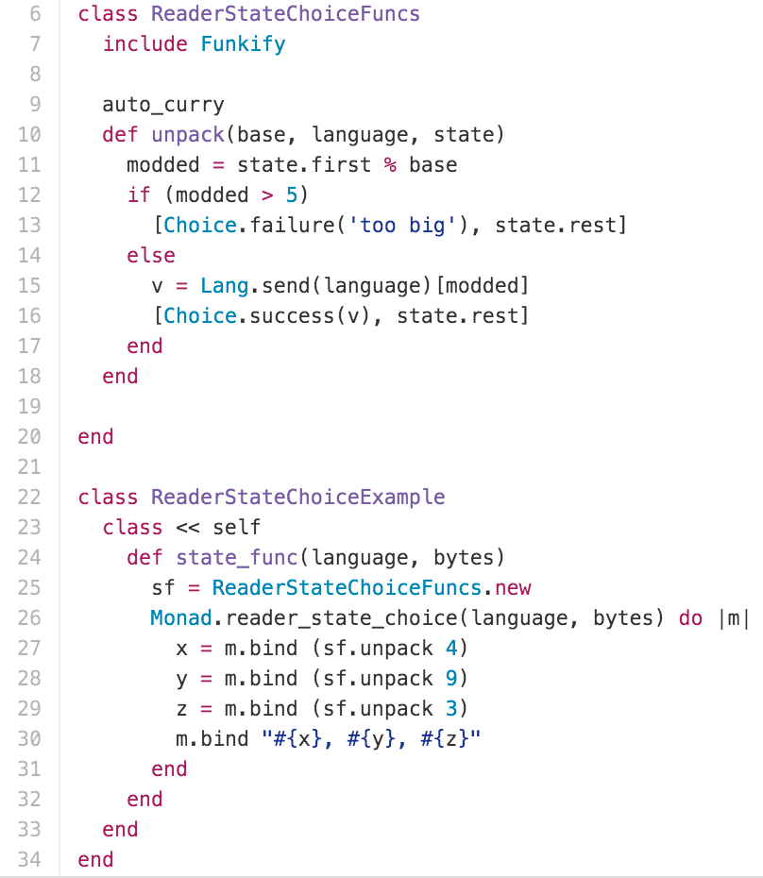
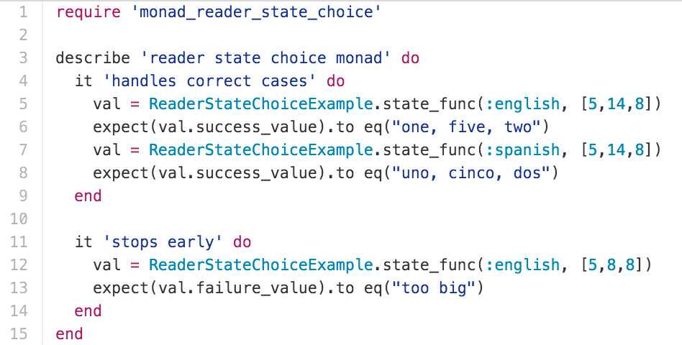
MONADS IN RUBY - MONADT

Slide 34
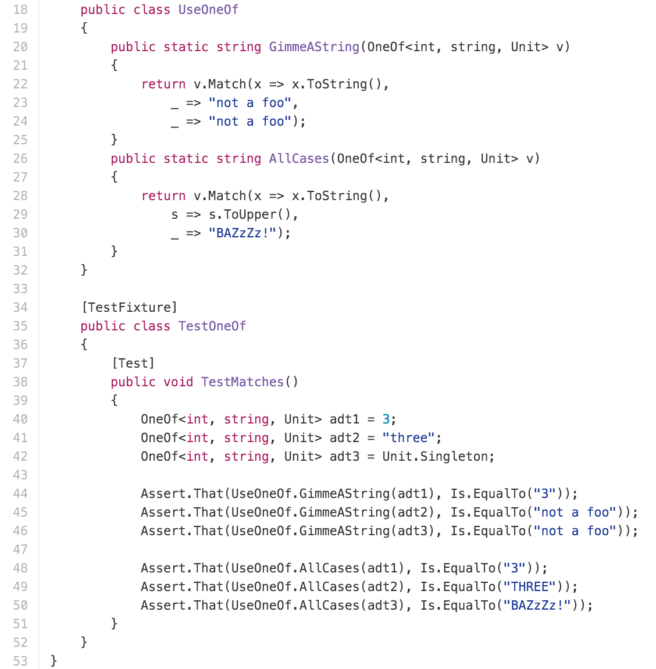
Algebraic Data Types IN C#

Slide 35
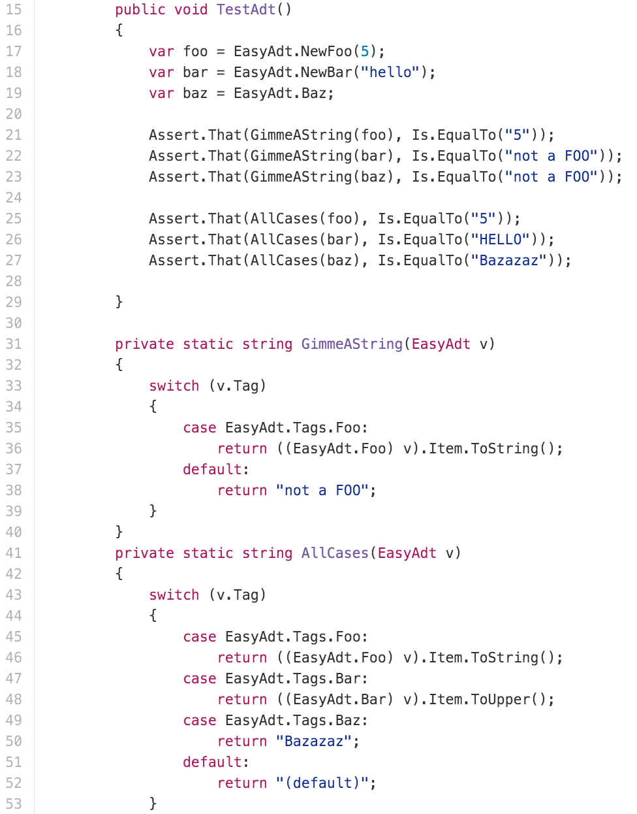
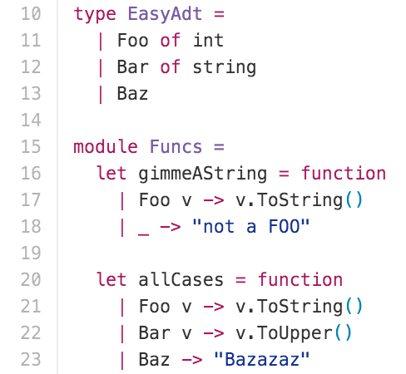
Algebraic Data Types IN C#

Slide 36
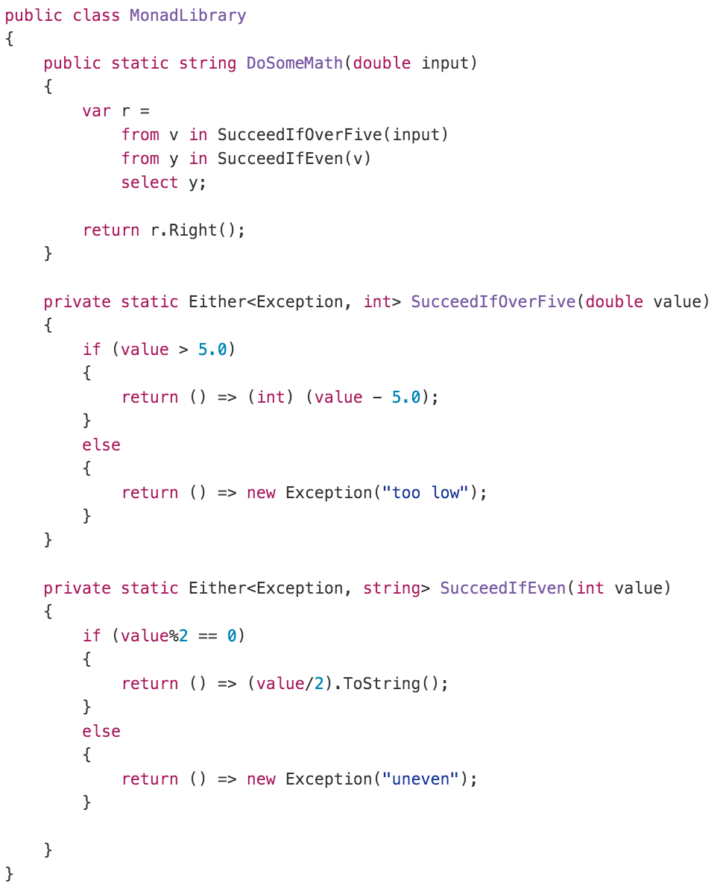
MONADS in C# - CSHARPMONAD

Slide 37
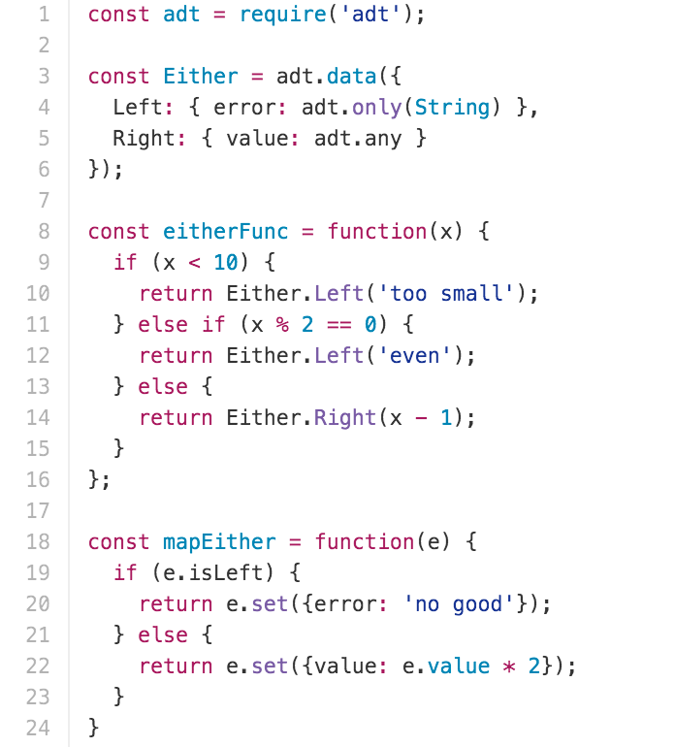
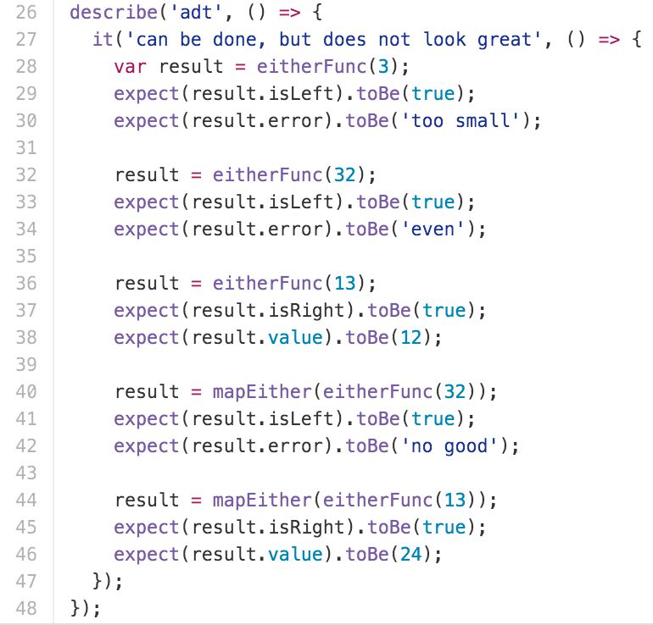
ADTS in JAVASCRIPT

Slide 38
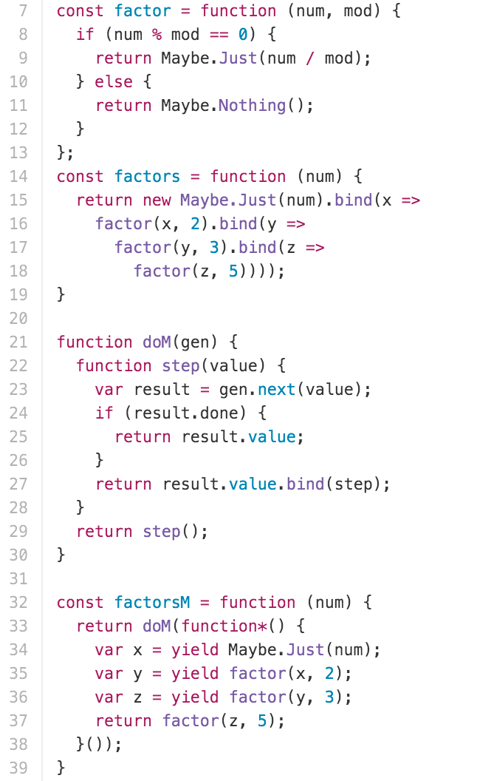
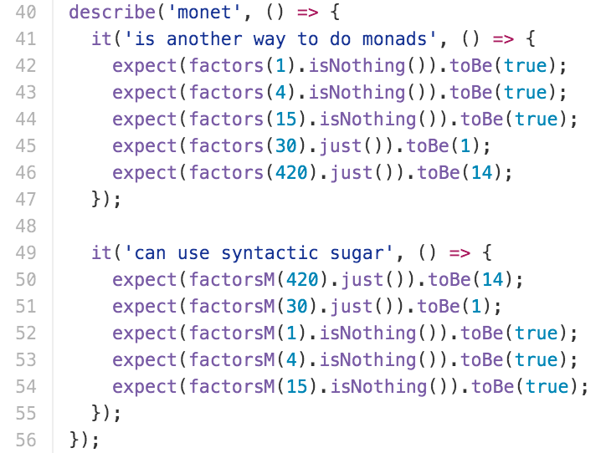
MONADS IN JAVASCRIPT

Slide 39
METAPROGRAMMING
Domain specific languages
Instruction “builders” (e.g. Ember Acceptance tests)
AST
Expression<> OR il construction in C#
RubyVM::InstructionSequence.compile in Ruby

Slide 40
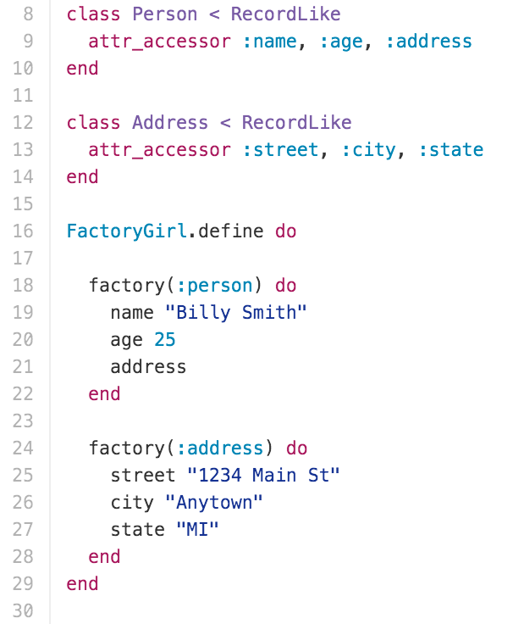
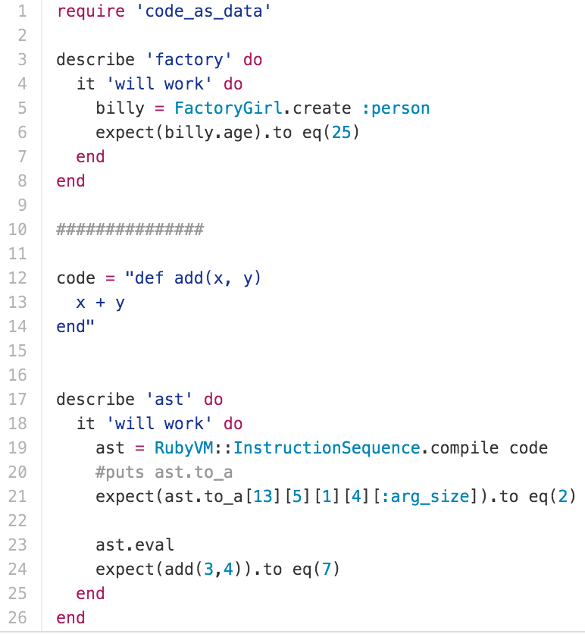
METAPROGRAMMING

Slide 41
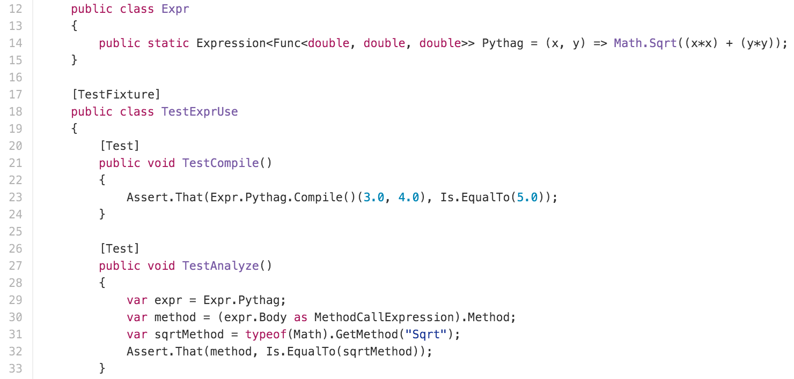
METAPROGRAMMING

Slide 42
LIBRARIES
RUBY | C# | JAVASCRIPT
hamsterdam | MethodToDelegate | adt
monadt |  | Immutable.js

Slide 43

Go forth and be functional
Will Pleasant-RYan
will.ryan@atomicobject.com
@KreliAnodos
https://github.com/willryan/functional-oo
https://github.com/willryan/MONADT (RUBYGEMS)
https://github.com/willryan/METHODTODELEGATE (NUGET)

